Slide 1
Schematic & Layout Design Course
Amir, Moshe, Tzippi ,Ron ,Lior, Oren and Moris | September 2025

Slide 2

Agenda
Motivation and Objectives
Syllabus Review & Course Structure
2MW, Kllund, Denmark
Installed by Sveigaard

Slide 3
Motivation & Objectives
Motivation:
Long editing process with many iterations --> Improve process
Professional gaps – New employees, fast promotions, non-unified process
Implementing new layout process
Objectives:
Provide practical and theoretical knowledge in SE schematic & layout process
Improve understanding of layout process stakeholders to foster better collaboration, reduce mistakes
Improve project layout process (shorter time, less iterations, less fixes/layout revisions)
Create unified working methods

Slide 4
Motivation
Why Layout Matters
  A robust layout process ensures fewer field issues.
  Reliable products strengthen SolarEdge’s reputation.
Impact of Poor Layout
  Delays project timelines and complicates future changes.
  Increases risk of costly rework and customer dissatisfaction.
Our Investment
  Significant time and top-tier expertise dedicated to this process.
  Expect equal commitment and active participation from all involved.

Slide 5
Motivation
Collaboration & Learning
  Diverse professional levels—everyone can contribute and learn.
  Encourage teamwork and mutual support during layout reviews.
About the Process
  This is the first iteration—improvements will follow.
  Feedback is essential to refine and optimize the workflow.
Your Role Moving Forward
  Be the spearhead of this new layout methodology.
  Act as a knowledge hub and set the standard for excellence

Slide 6
Course Syllabus
"Core" Group​
Ron Baruch | Schema
Amir Grossberg | Power, Layout Basics
Moris Ruso | Layout Guidelines
Lior Maor | Auxiliary, EMI, Layout Basics
Oren Saraf | Mech.
Moshe Raviv | Layout Process, Tools
All – Interactive workshop
Content Specific Owner
Uri Itzack | HW Development Process
Eytan Dahan | Digital
Naif Asakle | PCB
Moris Ruso | Routing Tips
David Braginsky | Analog
Shlomi Zadka | OPT
Yariv Shlivinski | Review
Daniela Popescu | ATE
Erez Gershgoren | Tools
Yevgeni Zemlinsky | AI Tools
Notes:
להוסיף זמנים שלקח לנו לפתח את הקורס
תהליך איטרטיבי, מתגלגל
חצי שנה עבודה

Slide 7
Course
Syllabus
  Layout Process​ Overview
  HW Development Process
Introduction
  Components and Installation​
  Orcad & DSN Basics​
  Orcad Advanced​
  Entering Layout​
Schematic Design
  Introduction to PCB Layout Design
  SE Layout Guidelines
PCB Layout Design
  ​
  Power Design Guidelines
  Auxiliary P.S ​​
  Analog Design ​​
  OPT ​​
  PCB Design for Testing and FA ​​
  ATE ​​
  Editing tools & AI
  PCB from Design to Applying ​
  Digital High-Speed Design ​
  Mechanical Considerations (HW-Mech) ​
  Routing Tips
  EMC Design Considerations
Specialization & Extras
  Interactive Workshop, from schema to layout – End of Course
Schedule.docx
Summary

Slide 8
Syllabus Review (#1)
Introduction to Layout Course | Moshe Raviv | 0.5 Hour | PPT in writing
Course Overview
  Motivation
  Course Objectives
  Schedule
  Expectations
  Course Requirements

Slide 9
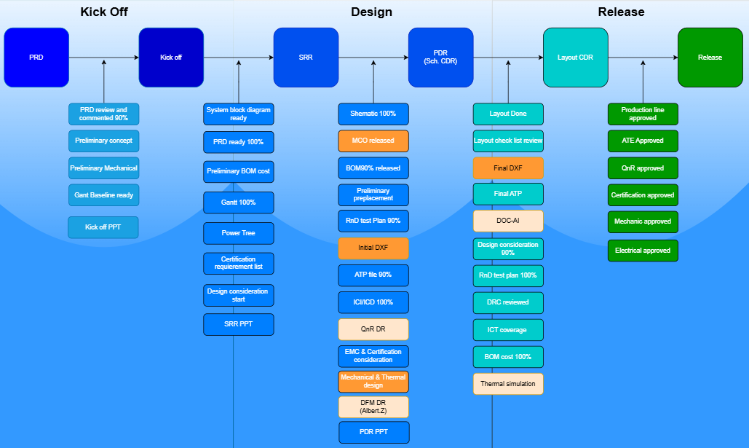
Syllabus Review (#2)
HW Development Process | Uri Itzack | 1.5 Hour | PPT in writing
HW Development: Presents the overall HW development process flow, including main milestones as PRD, Kick-off, SRR. PDR, Layout, Release and their sub-tasks.
(!) Flow needs to be approved before starting of the course – will be reviewed separately.

Slide 10
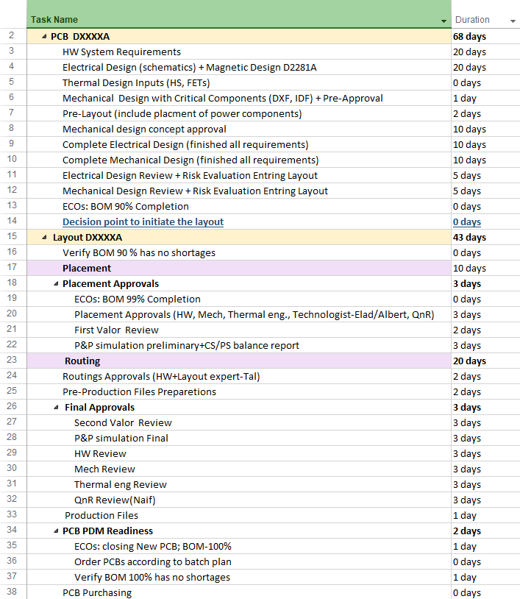
Syllabus Review (#3)
Introduction to Layout Process | Moshe Raviv | 1 Hour | PPT in writing
Motivation
Process Overview:
  Design
  Schematic/PCB creation
  Placement
  Routing
  Final approvals
Dep. and Engineers Responsibilities
Documentation

Slide 11
Syllabus Review (#4a)
PCB Schematic Design | Ron Baruch | 8 Hours | PPT
Component Selection & Requirements:
  Components selection based on ratings, packages, pulse rating
  Q&R, CTO guidelines, disqualified vendors, second sourcing, and production needs.
  Special components selection criteria: critical parts like MLCCs, connectors, and thermal-sensitive components.
OrCAD Tools & Workflow from A to Z:
  Installation guidelines, licensing (CIS, viewer), troubleshooting
  Project setup, symbol creation
  DSN management, version control
  Advanced features like OrcadX updates, PDF export
  Layout entry guidelines

Slide 12
Syllabus Review (#4b)
Design & Compliance Essentials:
  Creepage/clearance (UL/IEC), Netspace types
  ATPs, TPs, ICT definitions, Vertical Testing
  Net classifications (e.g., noisy, differential)
  Design rules for high-volume manufacturing (DFM/V)
Pre and Post layout Process Overview:
  Wirelist, Updating Cache, Board constraints (dimensions, holes, keep-outs)
  Collaboration with mechanical/HW engineers for Board constraints (dimensions, holes, keep-outs)
  Approval Process flow, Production files, ECOs for D and AP level

Slide 13
Syllabus Review (#5)
Intro to PCB Layout Design | Lior Maor & Amir Grossberg | 3 Hours | PPT
PCB Design Foundations:
  PCB layout preview
  PCB types, layer functions, component placement, and via types
Design Process & Requirements:
  Pre-requirements overview
  Schematic design
  Layout workflow
  Design Rule Checking (DRC), and Design for Manufacturing (DFM)
Performance & Reliability Considerations:
  Signal integrity, EMC, impedance matching, crosstalk, thermal management, and use of thermal vias and heat sinks

Slide 14
Syllabus Review (#6)
PCB Layout Design | Moris Ruso | 3 Hours | PPT
SolarEdge-Specific Guidelines:
  Concludes with SE layout guidelines tailored to internal standards and best practices

Slide 15
Syllabus Review (#7)
PCB Layout Design | Moris Ruso | 1.5 Hour | PPT
Focused audience: Intended for layout group + specialists only
Orcad SPB22.1 Overview:
  Quick intro to the PCB design tool used in the layout examples
DDR3 Routing in PortiaX:
  Key routing practices for DDR3 using ISSI DRAM in the PortiaX board
Interface Layouts: Ethernet, eMMC, USB:
  Practical routing tips for Ethernet (TI DP83822), eMMC (S40FC002), and USB
Special Case: CR2032 Battery Holder:
  Handling undefined constraints and invisible layout rules in PortiaX/Linux

Slide 16
Syllabus Review (#8)
PCB from Design to Applying | Naif Asakle | 3 Hours | PPT#1, PPT#2
PCB Fundamentals & Technologies:
  PCB manufacturing, technologies and Material Overview
  Schematic design, layout, and thermal management strategies
Design Guidelines & Best Practices:
  Layout rules for high-speed design considerations, controlled impedance
  Comprehensive design checklists to ensure performance and reliability
SolarEdge-Specific Design Needs:
  Solaredge Special board design (e.g., Metal Core, IMS, Thermal PCBs)
  Assembly processes
  Key considerations like BOM and Valor script usage
Roles & Processes:
  Outlines the responsibilities in PCB and PCBA design within SolarEdge
  Design rules, approval stages
  integration with manufacturing workflows

Slide 17
Syllabus Review (#9)
HW Specification for Digital High-Speed Design | Eytan Dahan | 1.5 Hours | PPT
Core Concepts & Signal Integrity:
  Introduces digital high-speed design
  signal integrity fundamentals
  transmission lines and controlled impedance
Design Challenges & Solutions:
  Common signal integrity issues
  power integrity (PDN), and their relationship with EMI
Schematic & Layout Practices:
  Schematic design
  stack-up planning
  footprint creation
  placement, routing strategies, and via usage
Best Practices & Summary:
  Emphasizes layout recommendations for high-speed signals and concludes with key takeaways for robust digital design

Slide 18
Syllabus Review (#10)
Mechanical Considerations (HW & Mech side) | Oren Saraf | 2 Hour | PPT
Electronic Designer Preparations
  Hardware-side constraints
Mechanical Designer Responsibilities & Thermal Design
  Mechanical requirements
  Thermal management strategies
Production Constraints: Focuses on manufacturability, assembly limitations, and design readiness for MP
HW & Mechanical Collaboration: Iterative layout process between hardware and mechanical teams.
File Deliverables & Formats:
  Lists required mechanical files such as drawings, DXF, 3D models (STEP, X_T, E-drawings), and layout files (IDF, drill drawings)
Placement & Change Management:
  Addresses component placement coordination, handling modifications, and preparing mechanical files for ECO processes

Slide 19
Syllabus Review (#11)
EMC Design Considerations | Lior Maor | 2 Hour | PPT
EMI Basics & Testing:
  Introduces electromagnetic interference (EMI)
  Regulatory limits for conducted and radiated emissions
  Testing methods including DC conducted emissions and immunity evaluations
Noise Types & Sources:
  Understanding Common Mode (CM) and Differential Mode (DM) noise
  Identifying which components typically generate each type of interference
Filtering Techniques:
  EMC components (like chokes and capacitors) used to suppress noise
  Optimal placement for effective filtering
Real-World Layout Examples:
  EMI mitigation strategies through case studies from Jupiter+, Jupiter 3, Venus 3, Venus 4, and RSS2.5 designs

Slide 20
Syllabus Review (#12)
Power Layout General Design Guidelines | Amir Grossberg | 1.5 Hour | PPT
Signal Return Path & Physics Refresher:
  Reviews basic physics concepts (Faraday Lenz rules)
  Explains how signal return paths behave (DC and AC)
  The di/dt effect and it's impact on layout
Power Layout Principles:
  General design guidelines for power circuits
  Layout strategies for power topologies. Examples of basic buck converter and gate driver layout
Capacitance & Grounding:
  The dv/dt effect: parasitic layput capacitance
  Best practices for designing GND planes,
  Layout examples.
Practical Layout Considerations:
  Focuses on real-world layout decisions that affect performance, including component placement and grounding for power integrity

Slide 21
Syllabus Review (#13)
Auxiliary Power Supply Layout Design | Lior Maor | 2 Hours | PPT
Aux Power Basics:
  Introduces the range of auxiliary power supplies and typical load types, providing foundational context for layout design
Component Placement & Optimization:
  Key considerations for power components placement
  Return paths management
Flyback Switching & Layout Guidelines:
  Understanding flyback converter basic operation
  Flayback layout best practices to manage noise, efficiency, and thermal performance
Real-World Design Examples:
  Real SE layout examples from Portia X (AP1999B), Neptune (AP2290A), Jupiter 3 (AP2214BA), and Orion (AP1391CA, AP1551C)

Slide 22
Syllabus Review (#14)
Analog Design: Layout Theoretical & Practical Aspects | David Braginsky | 3 Hours | PPT
Theoretical Foundations:
  Covers differential vs. common currents,
  Signal routing, return paths, grounding techniques, and crosstalk between PCB traces
Noise Control & Stability:
  Filtering and decoupling strategies to maintain signal integrity in analog circuits
Practical Layout Techniques:
  Layout for op-amp
  Current and voltage sensing,
  PLC layout
Grounding & Mixed-Signal Design:
  Analog-to-digital ground connections
  Practices for managing shared ground planes

Slide 23
Syllabus Review (#15)
OPT Layout Design Considerations | Shlomy Zadka | 1.5 Hour | PPT
Introduction & Layout Guidelines:
  Overview of power optimizers
  Key layout considerations to ensure performance and reliability
Failure Modes & Design Risks:
  Real-world layout failure examples including 4-wire design issues, static planes
  Thermal plane challenges.
DFM & Production Readiness:
  Covers Design for Manufacturing (DFM) aspects like AAC/ATE and operational event handling
Noise & Signal Integrity:
  Noise sources and mitigation strategies in layout to maintain signal quality

Slide 24
Syllabus Review (#16)
PCB Design for Testing and FA | Yariv Shlivinski | 1.5 Hour | PPT
Design for Testability:
  Layout strategies that support efficient testing, including test point placement and signal accessibility
Failure Analysis & Mitigation:
  PCBs design for simplify root cause analysis and reduce the likelihood of recurring issues
Lab Testing Readiness:
  Layout features that facilitate hands-on lab testing, such as probe-friendly zones and clear signal paths
Integrated Design Approach:
  Encourages collaboration between design, validation, and FA teams to embed test and analysis capabilities from the start

Slide 25
Syllabus Review (#17)
ATE Requirements & Considerations | Daniela Popescu | 2 Hours | PPT in writing
Introduction to ATE
  An overview of the ATE group’s structure and role in testing electronic boards at the end of production
Types of Testers & Design Needs
  Explains ICT vs. ATE testers, what each is used for, and what design files (DSN) must include to support testing
Layout & Testing Guidelines
  Covers how to design the PCB layout to support testing, including test point placement and spacing rules
From Test Setup to PCB Approval
  Describes the physical test setup (pin bed) and the checklist for approving a PCB for production testing

Slide 26
Syllabus Review (#18)
Layout Tools | 2 Hours | Not final
  Clearance creepage - Erez Gershgoren
  Editing tools - Yevgeni Zemlinsky and more
  AI Tools - Yevgeni Zemlinsky
Overview:
  Introduction to the purpose and scope of the tools
Present Tool:
  Detailed walkthrough of the main editing tool being used, including key features and interface
Practice:
  Hands-on session or guided exercises to apply the tool in real scenarios

Slide 27
Syllabus Review (#19)
Interactive Layout Workshop | Core Group + Layout Team | 12 Hours
An interactive workshop, where participations will practice stages from schema to layout
Working in small groups, escorted by senior\layout
End-of course summary
Mandatory participation

Slide 28
Course Structure
Format:
~55 Hours
Schedule: 2 half days x 11 weeks
F2F meetings (Herzliya)
Mandatory attendance
Course materials (Teams learning hub, recordings, links & files)
Constant feedback (questioners & core group rep.)
Audience:
20 Participants
HW eng. + Layout team
All professional levels (junior to expert) + TLs
Notes:
מחברות מודפסות\ ריקות

